Slide 1
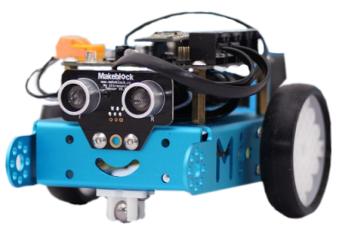
Intro to mBots
1

Slide 2
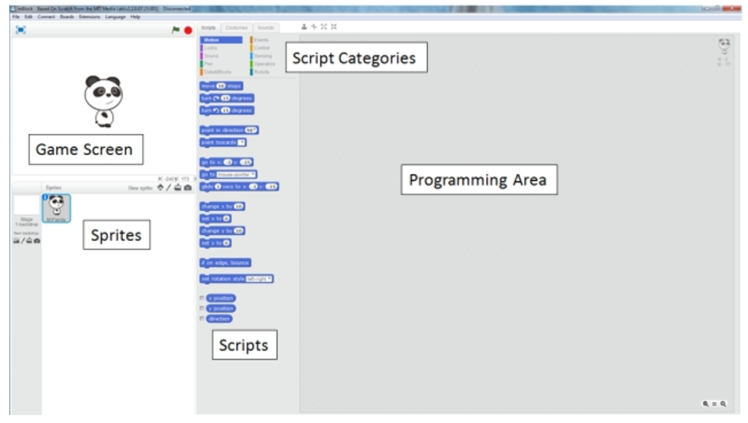

Slide 3
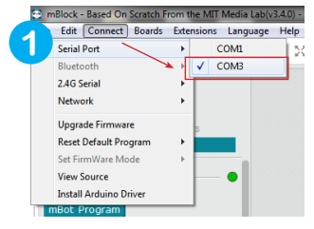
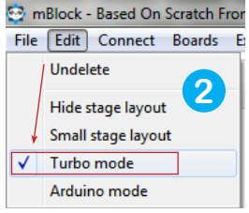
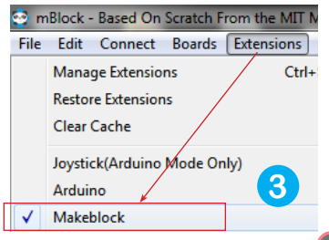
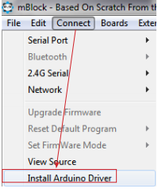
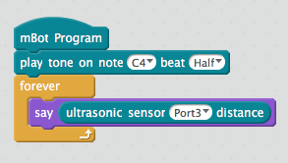
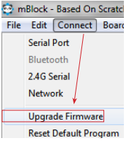
Plug in the mBot cable to the computer and turn the mBot on
Can’t see the serial port?
TEST Connection:

Slide 4
Overview
Led lights
Music Notes
Light sensor

Slide 5
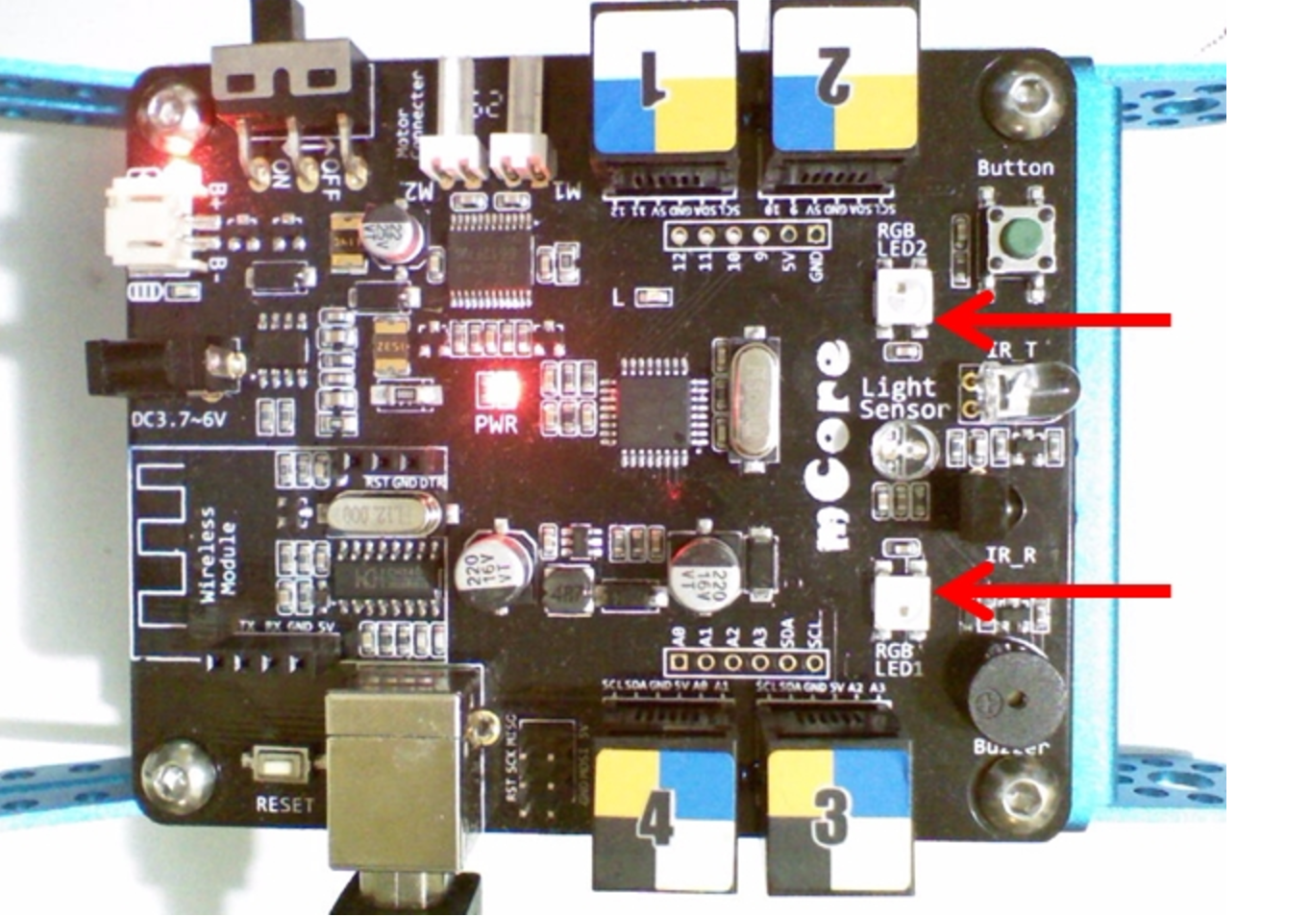
GET TO Know the Led lights
Notes:
There are 2 RGB LEDs on the mCore. RGB stands for Red-Green-Blue and LED stands for Light-Emitting Diode. Each LED can be assigned a level of red light, a level of green light and a level of blue light from 0 (light turned off) to 255 (light turned on full power). By combining these lights, you can make a wide range of different colors:

Slide 6
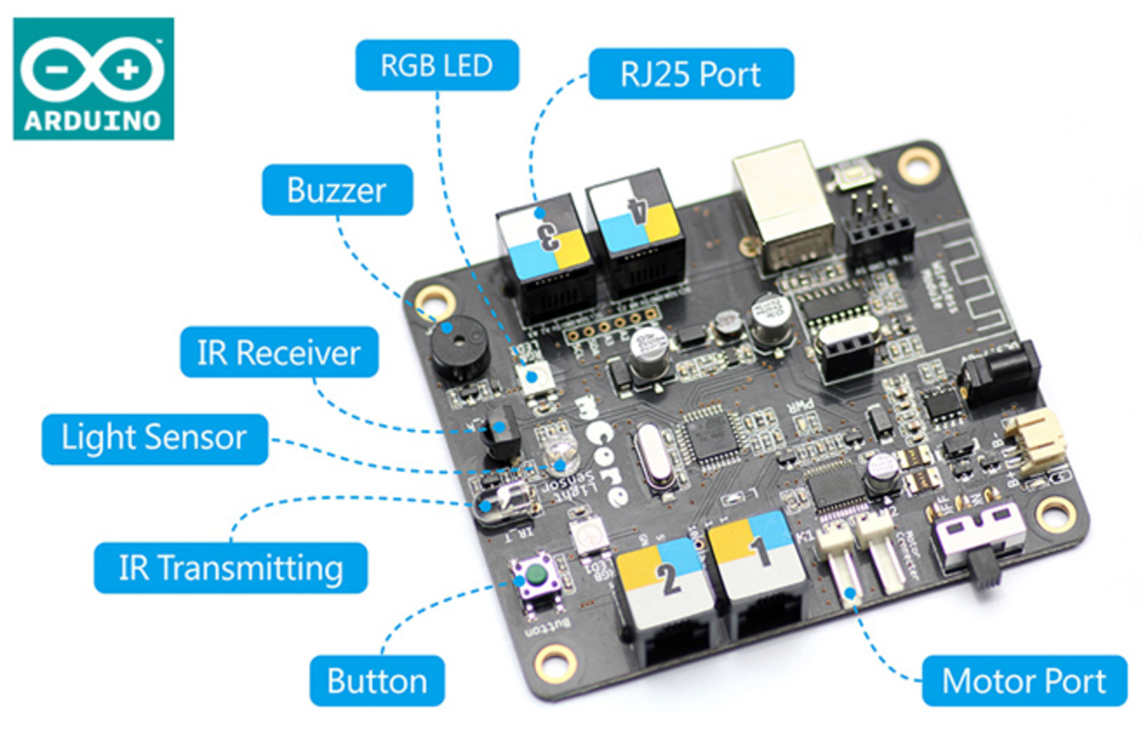
LED Display
2 RGB
Led lights
Notes:
There are 2 RGB LEDs on the mCore. RGB stands for Red-Green-Blue and LED stands for Light-Emitting Diode. Each LED can be assigned a level of red light, a level of green light and a level of blue light from 0 (light turned off) to 255 (light turned on full power). By combining these lights, you can make a wide range of different colors:

Slide 7
LED Display
Who knows what RGB stands for?
Notes:
There are 2 RGB LEDs on the mCore. RGB stands for Red-Green-Blue and LED stands for Light-Emitting Diode. Each LED can be assigned a level of red light, a level of green light and a level of blue light from 0 (light turned off) to 255 (light turned on full power). By combining these lights, you can make a wide range of different colors:

Slide 8
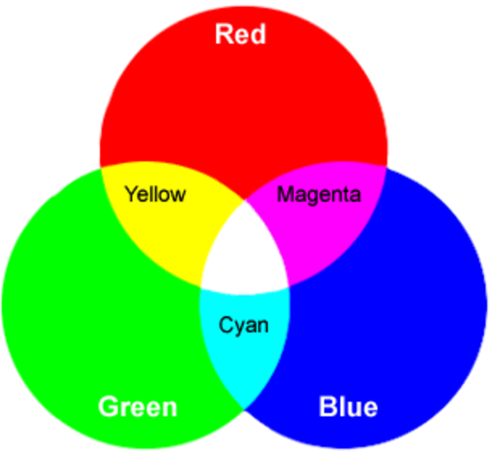
LED Display
Notes:
Additive color is color created by mixing a number of different light colors, with shades of red, green, and blue being the most common primary colors used in additive color system.

Slide 9
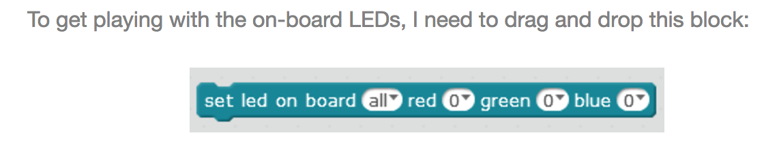
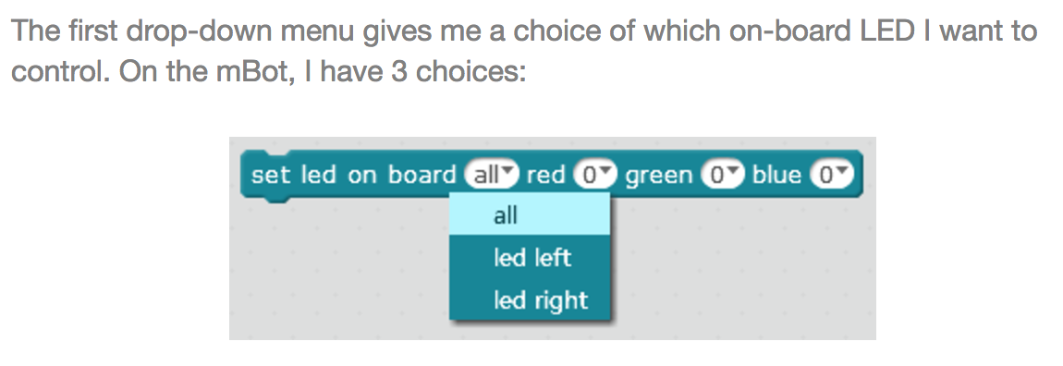

Slide 10
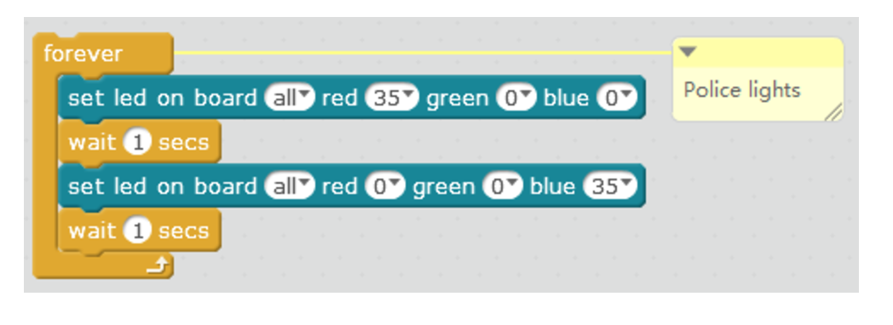

Try IT - Police Lights
Notes:
There are 2 RGB LEDs on the mCore. RGB stands for Red-Green-Blue and LED stands for Light-Emitting Diode. Each LED can be assigned a level of red light, a level of green light and a level of blue light from 0 (light turned off) to 255 (light turned on full power). By combining these lights, you can make a wide range of different colors:

Slide 11
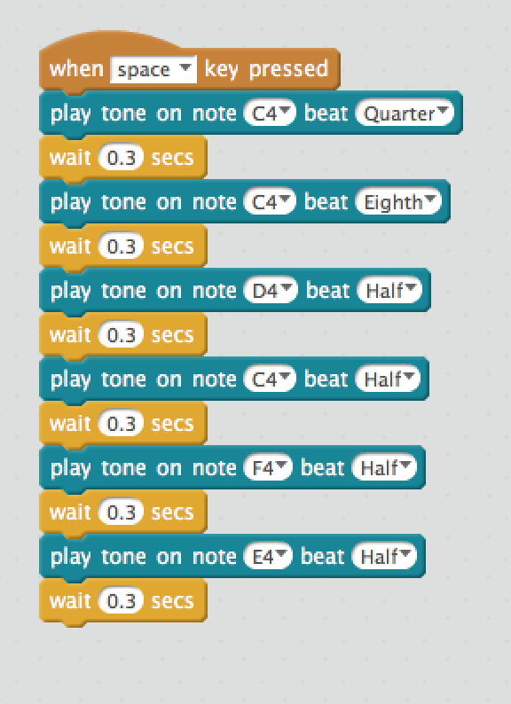
Buzzer
Notes:
There are 2 RGB LEDs on the mCore. RGB stands for Red-Green-Blue and LED stands for Light-Emitting Diode. Each LED can be assigned a level of red light, a level of green light and a level of blue light from 0 (light turned off) to 255 (light turned on full power). By combining these lights, you can make a wide range of different colors:

Slide 12
Get to know the buzzer
Use built in buzzer to play some music
Try to code your own song or make your own music
Notes:
There are 2 RGB LEDs on the mCore. RGB stands for Red-Green-Blue and LED stands for Light-Emitting Diode. Each LED can be assigned a level of red light, a level of green light and a level of blue light from 0 (light turned off) to 255 (light turned on full power). By combining these lights, you can make a wide range of different colors:

Slide 13
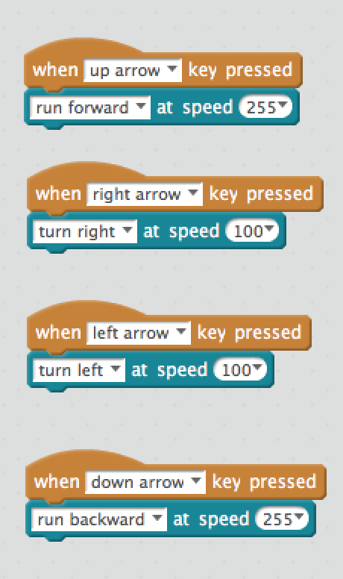
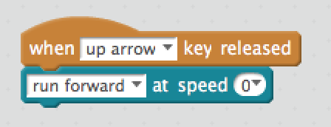
MOVING ROBOTS
?

Slide 14
POLICE LIGHTS

Slide 15

WARM UP Exercise
Make the robot go forward and stop when within 10cms of an obstacle
*Tip: use if statement

Slide 16
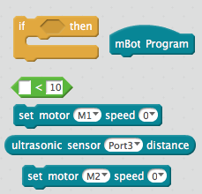
blocks
Make the robot go forward and stop when within 10cms of an obstacle
solution

Slide 17
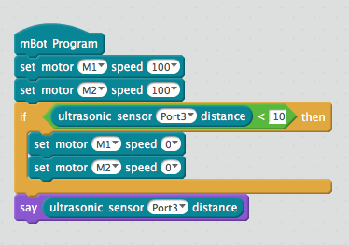
Sample solution

Slide 18


Sample solution
It has a bug!!
Notes:
The sample solution has a bug, can you point it?

Slide 19
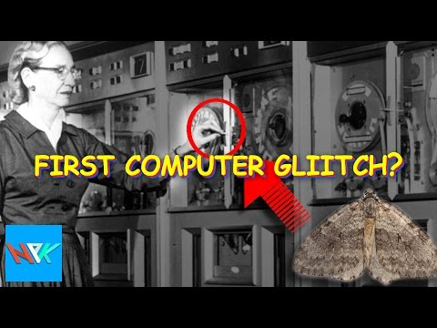
Aside

Slide 20

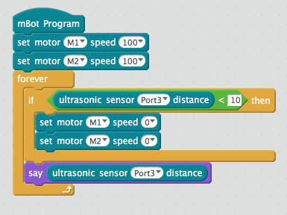
Fixing bug

Slide 21
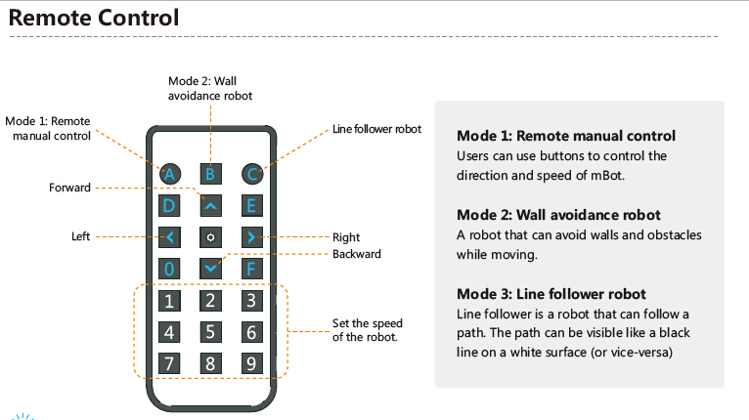
USING REMOTE CONTROL

Slide 22
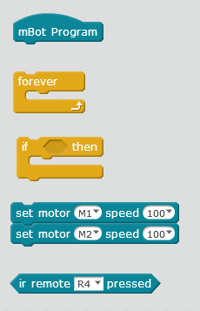
Exercise
1. Use the blocks below to assign following behaviour to Infrared Transceiver Module:
on 0 stop
on arrow up move forward
on arrow down move backwards
on arrow left move left
on arrow right move right
solution

Slide 23
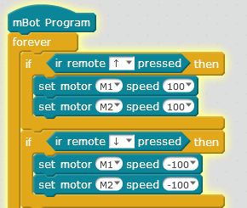
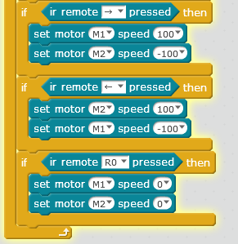
Sample solution

Slide 24
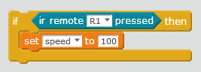
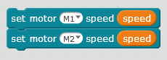
Challenge TASK:
Change speed
by setting A variable

Slide 25
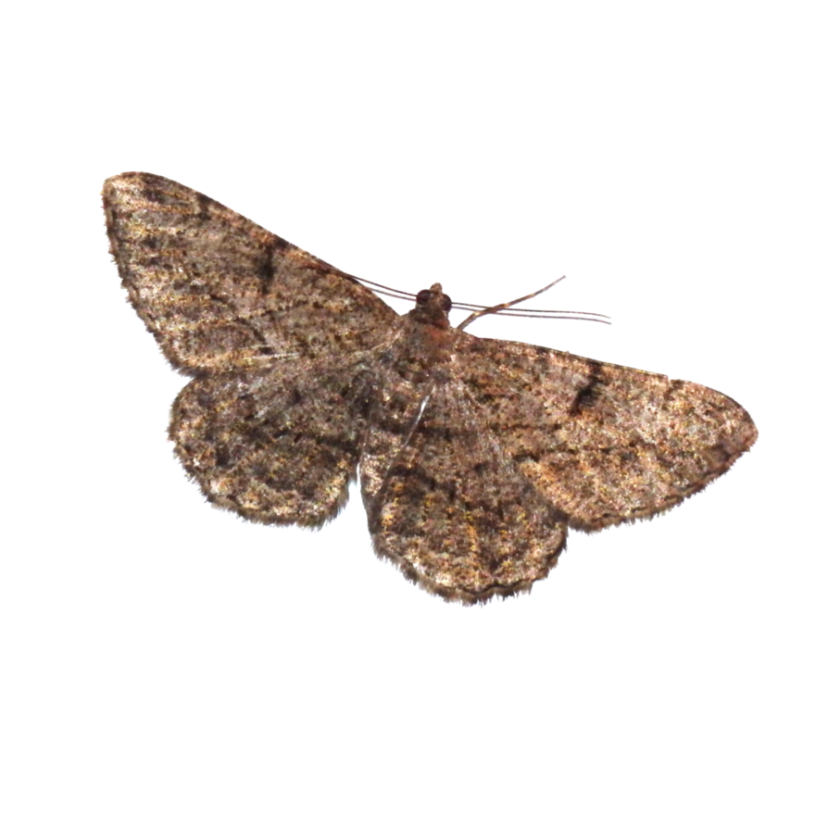



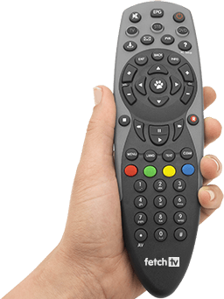
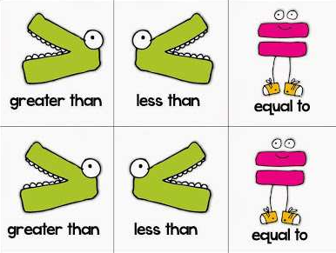
What have we learnt in the past two sessions?

Slide 26
What have we learnt today?
operations
Setting variables
If then condition
If then else condition
Origins of bug
Remote control
Light sensor

Slide 27

Thank you!
One Rule
Be Cool !

